Slide 1

Magnetic wireless Mobile Charger Electromagnetic Fields and Waves Course Project
Bhuvan A Kurakundi | 01FE20BEC170 (Roll no. 353)
Under the guidance of
Prof Vijay H M
2021-22, Even semester
KLE Technological University, Hubballi

Slide 2
AIM:
To construct the circuit that transfers the power wirelessly to achieve the objective of charging the mobile
METHODOLOGY:
By designing and constructing a method by circuit to transmit wireless electrical power (to transmit voltage) wirelessly from source to device using the properties and behaviour of Magnetic Field lines & Mutual Inductance.

Slide 3
Theory on Magnetic Field lines
Magnetic field is the region surrounding a magnet, in which the force of the magnet can be detected.
Magnetic field lines are a visual tool used to represent magnetic fields.
Magnetic fields occur whenever charge is in motion. As more charge is put in more motion, the strength of a magnetic field increases.
Magnetic field is a quantity that has both direction and magnitude. It is a vector quantity.
Magnetic field is created by an electric current or magnetic dipole and the field imparts magnetic forces on other particles that are in it.

Slide 4
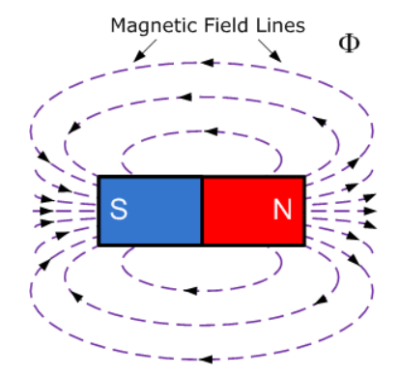
Pictorial Representation of Magnetic field lines
Where Phi ( Φ ) is Magnetic flux

Slide 5
Mutual inductance
Mutual inductance is the phenomenon of inducing the emf/current into the adjacent coil at its vicinity situated within the same magnetic field
Mutual Inductance is the basic operating principal of the transformer, motors, generators and any other electrical component that interacts with another magnetic field.
The effect of mutual inductance is very much dependent upon the relative positions or spacing

Slide 6
Illustration of relative positions or spacing for Mutual inductance
The amount of mutual inductance that links one coil to another depends very much on the relative positioning of the two coils. If one coil is positioned next to the other coil so that their physical distance apart is small, then nearly all of the magnetic flux generated by the first coil will interact with the coil turns of the second coil inducing a relatively large emf and therefore producing a large mutual inductance value
If the two coils are farther apart from each other or at different angles, the amount of induced magnetic flux from the first coil into the second will be weaker producing a much smaller induced emf and therefore a much smaller mutual inductance value.

Slide 7
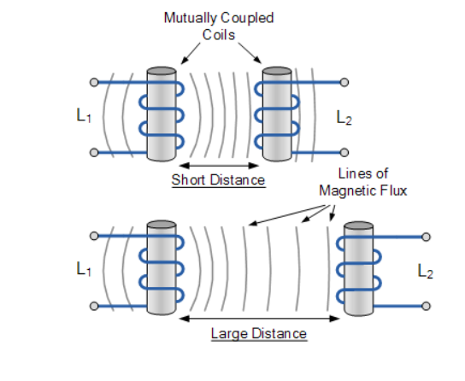
Illustration Continued:

Slide 8

Mutual Inductance (M) is given by:
Where:
µ_{o} is the permeability of free space (4.π.10⁻⁷)
µ_{r} is the relative permeability of the soft iron core
N is in the number of coil turns
A is in the cross-sectional area in m²
ℓ is the coils length in meters

Slide 9
Step Down transformer:
A step-down transformer is a type of transformer that converts the high voltage (HV) and low current from the primary side of the transformer to the low voltage (LV) and high current value on the secondary side of the transformer.
The operation of transformer is dependent on number of turns in the transmitter end and reciver end

Slide 10
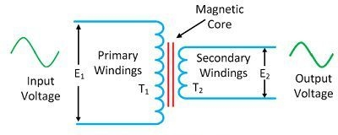


The relation is given by
therefore
Here Np>>Ns
Where
Vs is the voltage at reciver coil (secondary coil)
Vp is the voltage at transmitter coil (primary coil)
Ns is the number of turns in the reciver coil
Np is the number of turns in the transmitter coil

Slide 11
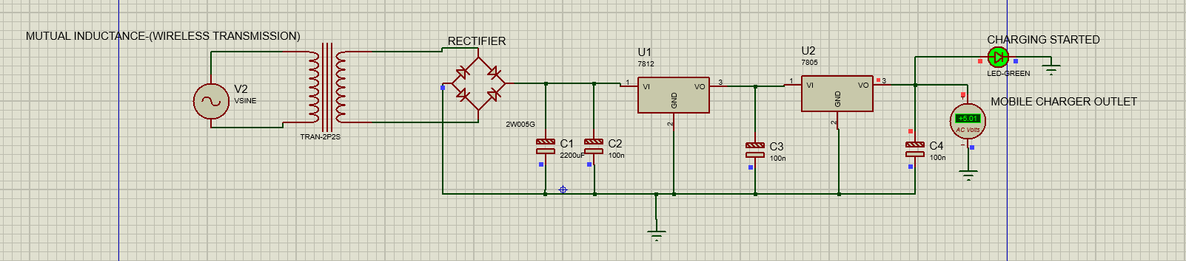
Circuit from simulation:

Slide 12
SOURCES
https://www.electronics-tutorials.ws/inductor/mutual-inductance.html
https://www.electrical4u.com/step-down-transformers/

Slide 14
Thank You

